Slide 1
GROUP MEMBERS:
Elysée NIYIBIZI - 2305000921
Yves BAHATI - 2305000895
Ange HIRWA - 2301001139
Esther NIYOKWIZERWA - 2305000181
Date: 5 April 2025

Slide 2
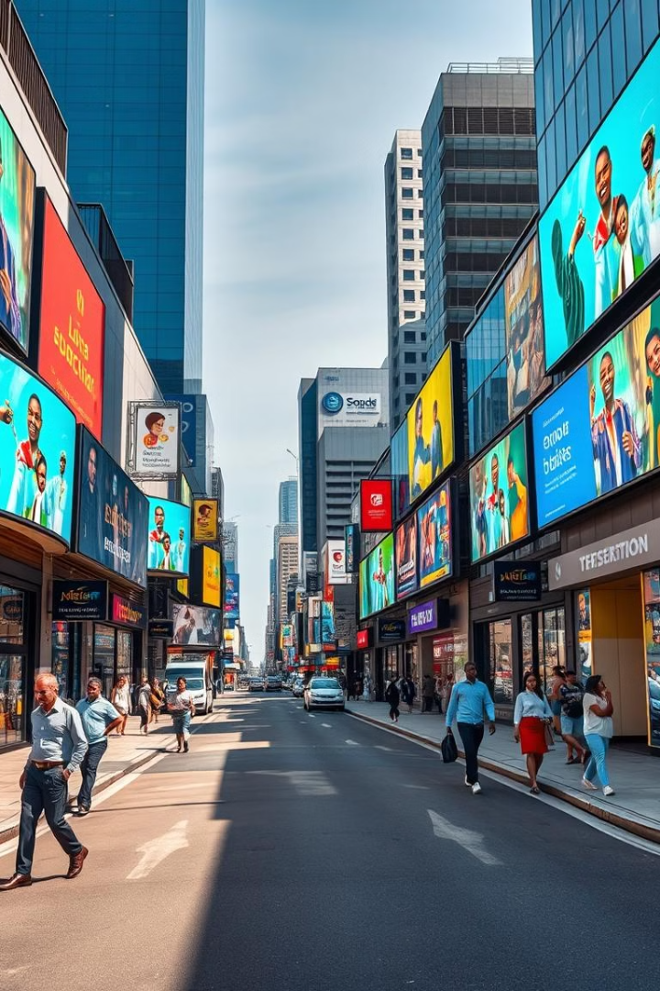
The Impact of Multimedia in Society
The world of multimedia encompasses various elements like text, audio, images, video, and interactivity, seamlessly integrated to enhance communication and information dissemination. In today's society, multimedia plays a crucial role in education, entertainment, and the rapid exchange of information. It has revolutionized how we engage with content, making it more captivating and accessible to diverse audiences worldwide. This presentation will explore the advantages and disadvantages of multimedia and discuss the strategies for preserving its rich potential in Africa for future generations.

Slide 3
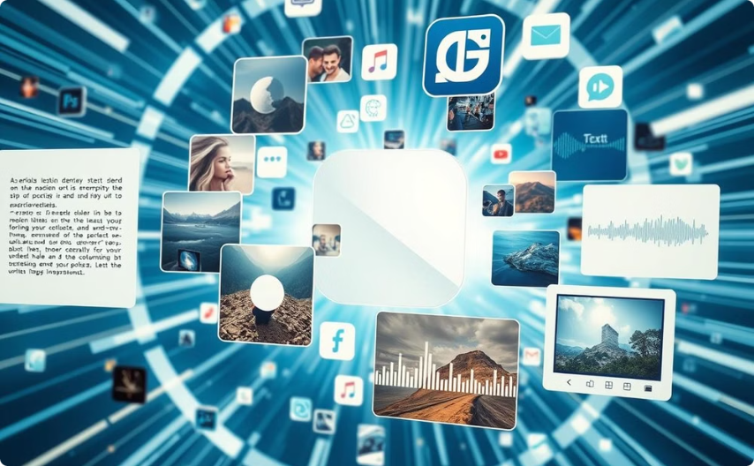
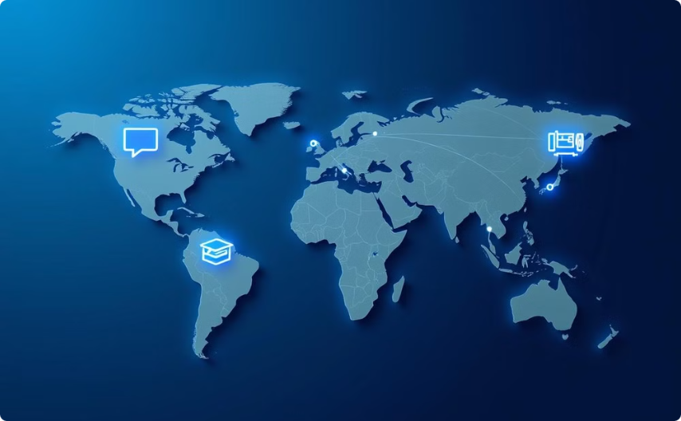
Introduction to Multimedia
Defining the Elements
Its Societal Importance
Multimedia is the integrated presentation of information through a combination of media elements. These typically include text, which provides a narrative or context; audio, which adds depth and emotion; images, which offer visual appeal; video, which delivers dynamic content; and interactivity, which allows for user engagement. Each element contributes to a richer, more comprehensive experience.
Multimedia has become indispensable in various facets of society. It enhances communication by making messages more engaging and understandable. In education, it caters to diverse learning styles, making complex concepts easier to grasp. For entertainment, it provides immersive experiences, and in information dissemination, it enables rapid and widespread communication across the globe.

Slide 4
Advantages of Multimedia
The widespread adoption of multimedia has led to a significant boost in engagement across various platforms. The use of visuals, audio, and interactive elements captures and retains audience attention more effectively than traditional methods. Multimedia is highly accessible, providing information in multiple formats to cater to diverse learning styles and abilities, making it ideal for global audiences. Through visual aids and interactive tools, complex ideas become more understandable and easier to grasp. Its global reach facilitates cross-cultural communication, connecting people from all corners of the world and enabling the sharing of diverse perspectives and ideas.

Slide 5

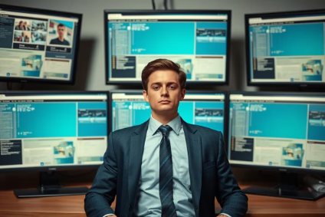


Disadvantages of Multimedia
The ease with which multimedia can spread information also presents significant challenges. Misinformation can proliferate rapidly through multimedia channels, leading to widespread confusion and potentially harmful consequences. Overreliance on multimedia for entertainment and social interaction can lead to digital addiction, reducing productivity and negatively impacting mental health. The digital divide exacerbates societal inequalities, as disparities in access to technology can prevent disadvantaged communities from fully participating in the digital world. Personal data is increasingly at risk due to the vulnerabilities of multimedia platforms, raising critical privacy concerns that need to be addressed.

Slide 6
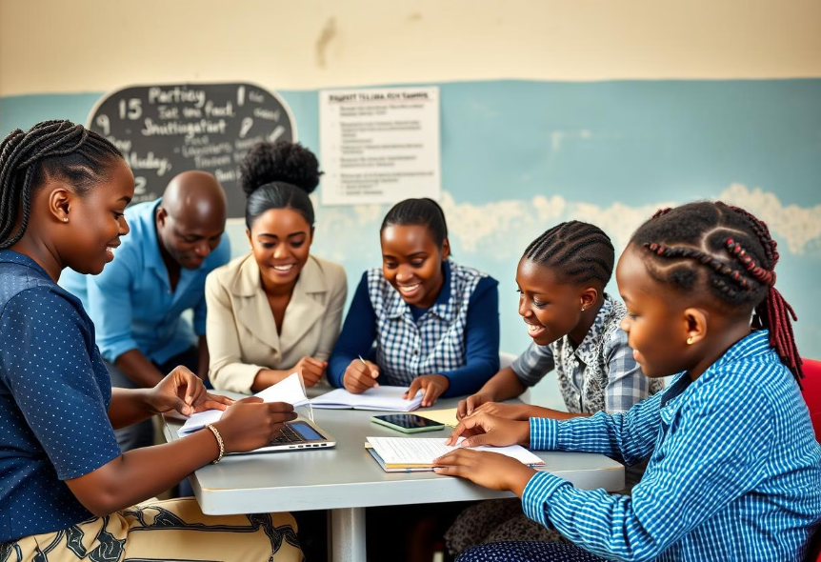
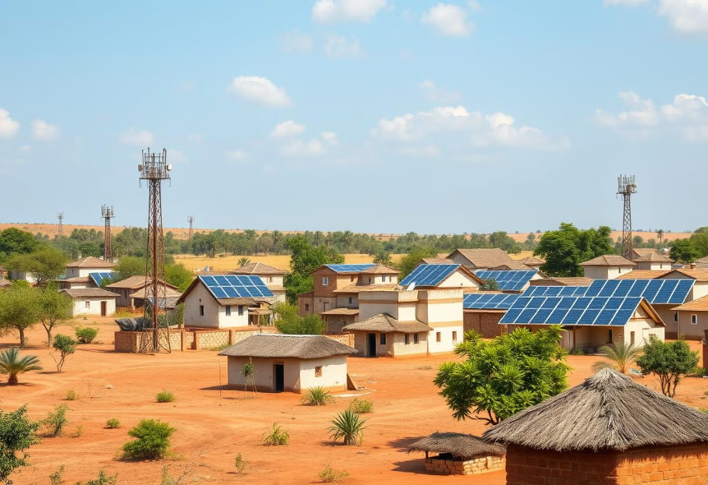
Strategies to Limit Disadvantages
Digital Literacy Programs
Infrastructure Development
Implementing digital literacy programs is essential to empower users to critically evaluate online sources and identify misinformation. These programs equip individuals with the necessary skills to navigate the digital landscape safely and responsibly. Encouraging balanced screen time habits and promoting alternative activities helps reduce the risks of digital addiction and its associated negative impacts. By fostering a healthy relationship with technology, individuals can maintain productivity and overall well-being.
Investing in infrastructure development is crucial for bridging the digital divide and ensuring that underserved areas have access to reliable internet and technology. This includes expanding broadband access, providing affordable devices, and supporting community technology centers. Providing education about data privacy and secure online practices is crucial to protect individuals from privacy risks. Users need to be informed about how their personal data is collected, used, and shared, and how to safeguard their information online.

Slide 7

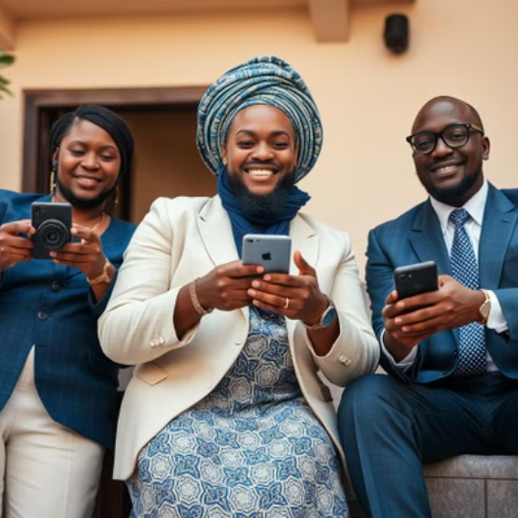
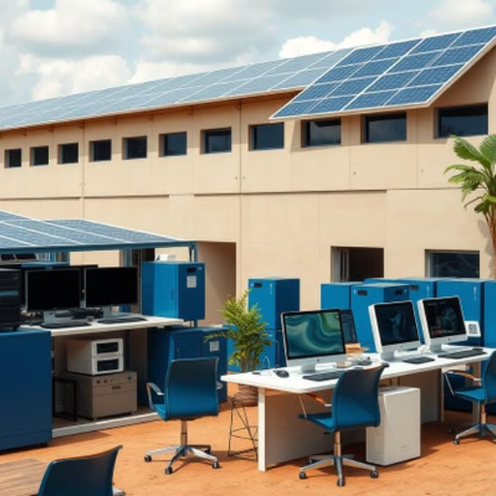
Preserving Multimedia for Future Generations
Leveraging multimedia to document and preserve African history, traditions, and cultural heritage is critical for ensuring that these valuable resources are accessible to future generations. This involves creating digital archives of oral traditions, historical artifacts, and artistic expressions. Supporting the creation of locally sourced and culturally relevant multimedia content is essential for promoting indigenous voices and perspectives. By encouraging local content creators, we can foster a vibrant and diverse digital landscape that reflects the richness of African cultures. Adopting eco-friendly practices in technology production and usage helps minimize the environmental impact of multimedia. This includes using renewable energy sources, promoting responsible e-waste management, and advocating for energy-efficient devices.

Slide 8
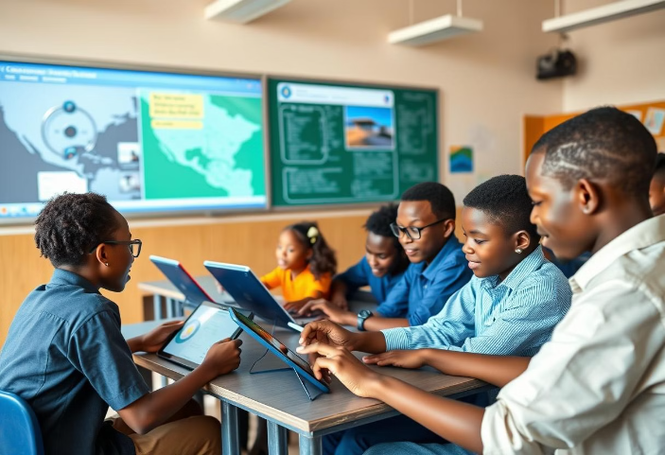
Role of Education
Integrating Multimedia in Curriculum
Integrating multimedia tools into educational settings can significantly enhance the learning experience. Interactive simulations, educational videos, and multimedia presentations can make complex concepts more engaging and accessible for students. Equipping teachers with the skills to effectively use multimedia in classrooms is crucial for maximizing its educational impact. Training programs should focus on pedagogical techniques, multimedia creation tools, and best practices for integrating technology into the curriculum. By fostering a supportive learning environment, educators can empower students to become critical consumers and creators of multimedia content.

Slide 9
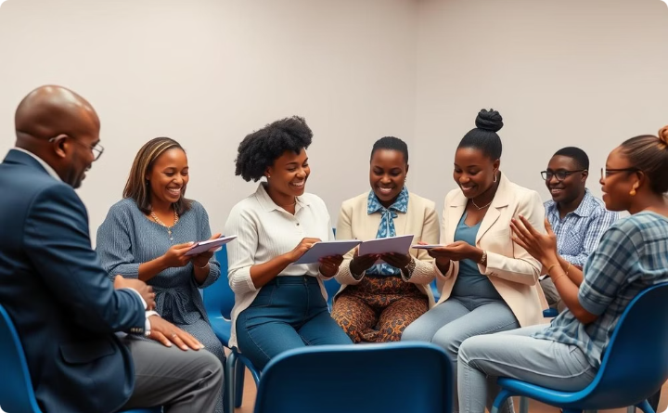
Community Involvement
Workshops and Seminars
Organizing workshops and seminars to raise awareness about multimedia literacy within local communities is an effective way to empower individuals with essential skills. These events should focus on critical thinking, digital citizenship, and responsible online behavior. Partnering with non-governmental organizations (NGOs) that specialize in digital education and access can amplify the impact of community-based initiatives. These collaborations can provide additional resources, expertise, and support for multimedia literacy programs, ensuring that they reach a wider audience.

Slide 10
Future Trends in Multimedia
Virtual Reality (VR) and Augmented Reality (AR) hold immense potential for transforming education and training. Immersive VR experiences can simulate real-world scenarios, while AR can overlay digital content onto the physical environment, enhancing learning outcomes. Future multimedia platforms will offer greater interactivity, allowing users to actively participate in the learning process. Interactive simulations, personalized feedback, and adaptive content delivery can create more engaging and effective educational experiences. Artificial intelligence (AI) can personalize multimedia experiences by analyzing user preferences, learning styles, and performance data. AI-powered systems can recommend relevant content, provide personalized feedback, and adapt learning pathways to meet individual needs.

Slide 11
END.
Thank you!

